Slide 1
19CS211 Computer Organisation and Architecture Session 3 (08-01-2021) Dr V Anantha Narayanan

Slide 2
Von-Neumann & Harvard Architecure

Slide 3
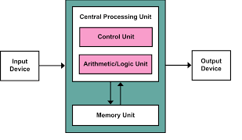
A Processing unit that contains an arithmetic logic unit and processor registers
A control unit that contains an instruction register and program counter
Memory that stores data and instructions
External mass storage
Input and output mechanisms
Von Neumann architecture or
Princeton architecture
Program instructions and data share the same memory and pathways.

Slide 4
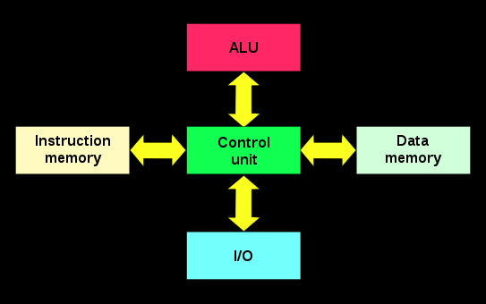
Harvard Architecture
The Harvard architecture is a computer architecture with separate storage and signal pathways for instructions and data. It contrasts with the von Neumann architecture, where program instructions and data share the same memory and pathways.

Slide 5
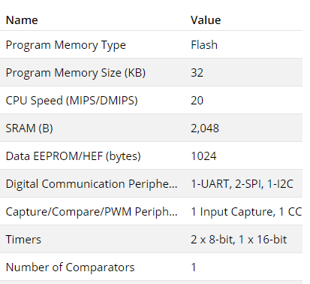
ATMega 328
Which Architecture it belongs to ???

Slide 6
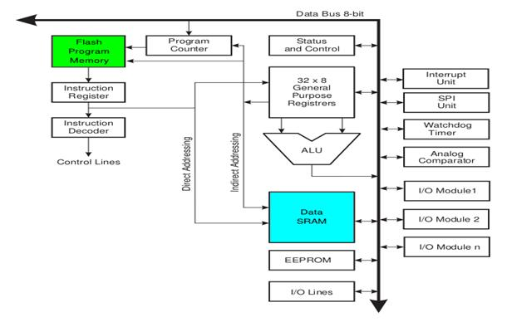

Slide 7
CISC vs RISC

Slide 8
CISC Processor
It is known as Complex Instruction Set Computer.
It was first developed by Intel.
It contains large number of complex instructions.
In this instructions are not register based.
Instructions cannot be completed in one machine cycle.
Data transfer is from memory to memory.
Micro programmed control unit is found in CISC.
Also they have variable instruction formats.

Slide 9
RISC - Reduced Instruction Set Computer
It is a type of microprocessor that has a limited number of instructions.
They can execute their instructions very fast because instructions are very small and simple.
RISC chips require fewer transistors which make them cheaper to design and produce.
In RISC, the instruction set contains simple and basic instructions from which more complex instruction can be produced.
Most instructions complete in one cycle, which allows the processor to handle many instructions at same time.
In this instructions are register based and data transfer takes place from register to register.

Slide 10
Intel (CISC) believes in hardware bearing more responsibility, making the coding simple. I.e. the developers shall be writing minimal lines of code. Apple (RISC) believes the other way round. The philosophy is, hardware has to be simple and software has to lift most of the responsibility. Means, the developers will have a tough job of writing more lines of code with this architectural approach

Slide 11
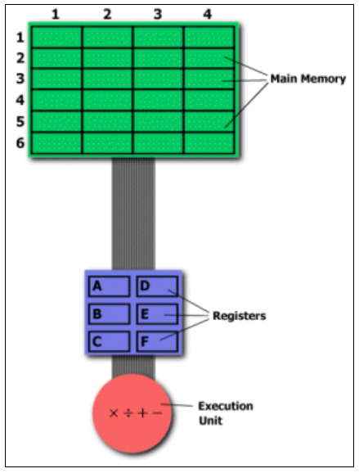
MULT 2:3, 5:2
LOAD A, 2:3 LOAD B, 5:2 PROD A, B STORE 2:3, A

Slide 12
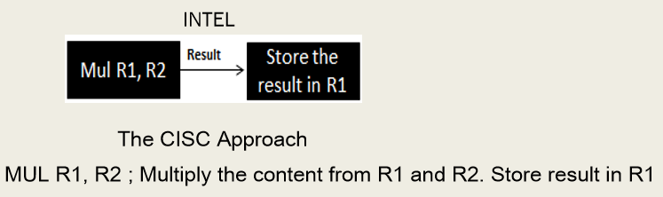
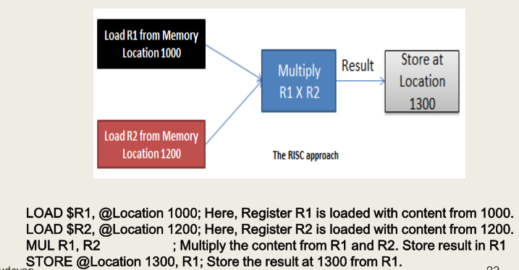
MULT 2:3, 5:2
RISC
Approach
ARM CPU
LOAD A, 2:3 LOAD B, 5:2 PROD A, B STORE 2:3, A

Slide 13
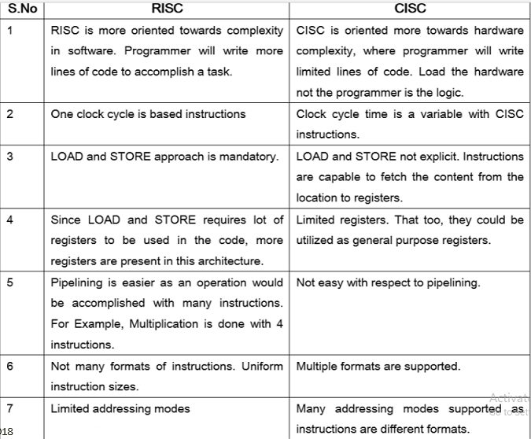

Slide 14
Basic Concepts

Slide 16
■ Program counter: A register which holds the address of the next instruction (subsequent instruction) to be executed. This enables faster execution. Program counter is a register and it cannot be accessed by the programmer. Or, the programmer does not know the address of the program counter. It is purposefully hidden from the programmers view.
■ Stack and Stack Pointer: Stack is a temporary storage area where the values can be stored. For an instance when a function is called like add (3,4), the arguments 3,4 would be kept in the stack (the operation is called pushing) and it is a temporary storage area. Once the function call is done and result is ready, the result will be again kept on the top of the stack. Once the execution is complete, the stack can be cleaned (the operation is referred to as popping). Stack pointer is a register used to point the stack.
■ Bus: The channel through with the information flows. The data could be the address or the data from a particular location. If the bus carries the data, it is called data bus and in case addresses go through the bus, it is referred as address bus. There are control signals to be sent for controlling actions and in that case, the bus is referred as control bus

Slide 17
Instruction and Execution Cycle
■ A program is nothing but collection of instructions and all the instructions gets pulled one after another from the memory (don’t worry which memory we are talking about, it is just memory).
■ Then, the process of understanding what the instruction is all about begins.
■ Followed by this, there would be computation and storing the result.
■ One can simply call this as Fetch, Decode and Execute, which is more technical as well.
■ But, to establish a better understanding it is needed to go with a deeper flow.

Slide 18
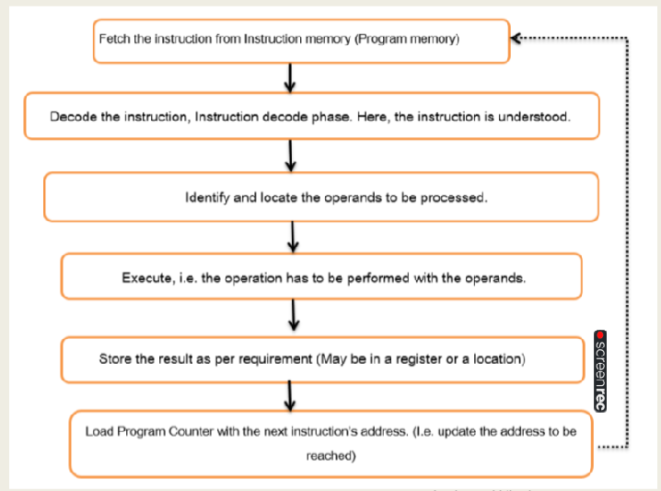

Slide 19
End of Session 3

